Slide 1
CBME/CBD Overview & Plans for Internal Medicine
Dr. Jeannette Goguen, MD, MEd, FRCPC
Program Director, Internal Medicine
Dr. Susan Glover Takahashi, PhD, Director, EIG, PGME
Notes:
Hello, my name is Jeannette Goguen and I am the Program Director for Internal Medicine at U of T. I would like to spend the next 12 minutes providing an overview of Competency-Based Medical Education (or "Competency by Design", as the Royal college calls it), from the Internal Medicine perspective.
I am using slides designed by the UT CBD group.

Slide 2
Overview
CBME & CBD overview
Key differences with CBD
IM roll out of CBD, highlighting EPAs
“Failure to Fail” & Giving Feedback
More information:
DOM CBD website
U of T CBME website
Notes:
This talk provides an overview of CBME and CBD, and describe key ways that CBD differs from we are doing now. We will introduce EPAs ("Entrustable professional activities", in the context of our program.

Slide 3
CBD or Competence by Design
Royal College’s approach to CBME
Rollout for approx. 80 specialties in 7 cohorts over next decade
Internal Medicine – Pilot starts Aug 1, 2017 TTD1
Notes:
The Competence by Design initiative of the Royal College is a major, multi-year project which implements an enhanced model for competence-based medical education (CBME) in residency training and specialty practice in Canada.
The IM pilot starts Aug 1 of this year.

Slide 4
CBME is an educational model that is…
More oriented to outcomes rather than time in training (i.e. what trainee can DO)
More flexible to learners’ prior skills and current needs
Training using a coaching approach with more regular feedback & entrustment decisions
Enhanced tracking of learners’ progress and performance

Slide 5
What are we trying to fix?
Have you ever...
Wanted to get teaching back to the bedside?
Gone to fill out an evaluation form and didn’t have enough data to be confident in your assessment?
Been afraid of retribution if you were to say something negative to a trainee about their performance?
Seen a resident in difficulty as a senior and wondered why the problem wasn’t identified and addressed earlier?
Wished that difficulties could be fed forward so the resident could be mentored and re-assessed in a timely fashion?

Slide 6
Big Picture for Internal Medicine
Stages of Training
Curriculum design- longitudinal coaching
EPAs (amongst other assessments)
Each assessment is one small piece of the puzzle
Competence Committee
Puts the puzzle together!
Notes:
Let's apply the model to Internal medicine.
We could look at each of the following: how the stages of training fit into the IM program, how we apply longitudinal coaching to curriculum design, what the Entrustable Professional Activities (EPAs) look like in Internal medicine, where each assessment is one small piece of the puzzle, and finally, how the Competency committee puts the pieces of the puzzle together, and determines if a resident is ready to progress to the next stage of training.

Slide 7
Big Picture for Internal Medicine
Stages of Training
Curriculum design- longitudinal coaching
EPAs (amongst other assessments)
Each assessment is one small piece of the puzzle
Competence Committee
Puts the puzzle together!
Notes:
Today we will look at the Stages of training and the EPAs.

Slide 8
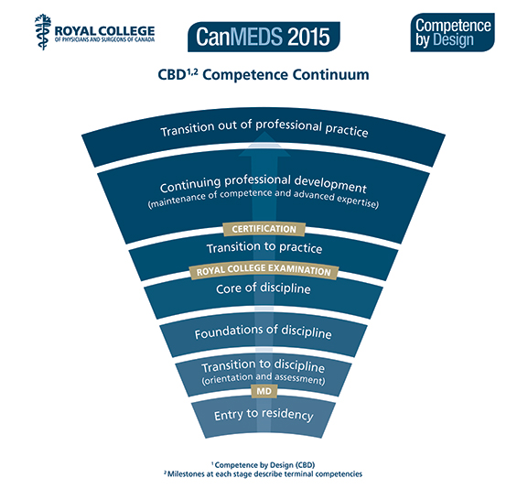
PGY4
PGY 2 & 3
PGY1 Blocks 5-13
PGY 1 First 4 blocks
Notes:
The stages of competency on the CBD Competence continuum start with Transition to Discipline, in the first four blocks of residency, when the trainee learns how to manage their new role as a resident. Foundation of discipline follows for the rest of the PGY1 year. The resident subsequently enters Core of Discipline for the PGY2 and 3 years, and finally, the PGY4 year is spent in Transition to practice, when the trainee practices the skills they will require to work as an independent internist when the training has been completed.

Slide 9
EPAs:
Assessing, diagnosing & managing patients with complex or atypical acute medical presentations
Assessing, diagnosing & initial management for patients with common acute medical presentations in acute care settings
Performing histories & physical exams, documenting & presenting findings, across clinical settings for initial and subsequent care
Notes:
Entrustable professional activities are the actions we do every day as internists. The abilities are graduated, depending on the stage of training. For instance..

Slide 10
Transition to Discipline EPAs (PGY1: Blocks 1-4)
EPA # | Title of EPA
TD1 | Performing histories and physical exams, documenting and presenting findings, across clinical settings for initial and subsequent care
TD2 | Identifying and assessing unstable patients, providing initial management, and obtaining help
TD3 | Performing the basic procedures of internal medicine

Slide 11
Foundations of Discipline - EPAs (PGY-1 – Blocks 5 - 13)
EPA # | Title of EPA
FD1 | Assessing, diagnosing, and initiating management for patients with common acute medical presentations in acute care settings
FD2 | Managing patients admitted to acute care settings with common medical problems and advancing their care plans
FD3 | Consulting specialists and other health professionals, synthesizing recommendations, and integrating these into the care plan
FD4 | Formulating, communicating, and implementing discharge plans for patients with common medical conditions from acute care settings
FD5 | Assessing and providing targeted treatment for unstable patients and consulting as needed
FD6 | Discussing and establishing patients’ goals of care
FD7 | Identifying personal learning needs while caring for patients and addressing those needs

Slide 12
Core of Discipline EPAs (PGY2&3)
EPA # | Title of EPA
CD1 | Assessing, diagnosing & managing patients with complex or atypical acute medical presentations
CD2 | Assessing, diagnosing, and managing patients with complex chronic diseases
CD3 | Providing internal medicine consultation to other clinical services
CD4 | Assessing, resuscitating, and managing unstable and critically ill patients
CD5 | Performing the procedures of Internal Medicine
CD6 | Assessing capacity for medical decision-making
CD7 | Discussing serious and/or complex aspects of care with patients, families, and caregivers
CD8 | Caring for patients who have experienced a patient safety incident (adverse event)
CD9 | Caring for patients at the end of life
CD10 | Implementing health promotion strategies in patients with chronic diseases
CD11 | Teaching and assessing junior learners through supervised delivery of clinical care

Slide 13
Transition to Practice (PGY4)
EPA # | Title of EPA
TP1 | Managing an inpatient medical service
TP2 | Managing a medical clinic
TP3 | Assessing and managing patients in whom there is uncertainty in diagnosis and/or treatment
TP4 | Providing consultations to off-site health care providers
TP5 | Initiating and facilitating transfers of care
TP6 | Working with other physicians and healthcare professionals to develop collaborative patient care plans
TP7 | Identifying learning needs in clinical practice, and addressing them with a personal learning plan
TP8 | Identifying and analyzing system-level safety, quality or resource stewardship concerns in healthcare delivery

Slide 14
Basic structure of EPA tools
Demographics
Elements
Global entrustment decision
Global comments, and next steps
Notes:
Let's discuss EPA assessment tools now!
There are four basic components:
1. The demographics which the resident can fill in, when they open the tool on their phone or a computer.
2. The elements (which are also called "milestones") you are expected to evaluate at least 3, including comments
3. Provide a global entrustment decision-- based on this particular assessment, would you judge them as entrustable to do this activity on their own next time?
4. Finally, please provide any summary comments and suggest some next steps for future improvement

Slide 15
Basic structure of EPA tools
Entrustment Scale for elements and global:
Autonomous and Consultancy level = Entrustable
Notes:
This is what the Entrustment scale looks like for Internal Medicine

Slide 16
Steps to completing an EPA form
Resident opens the EPA on medsquares and enters the demographics.

Slide 17
Steps to completing an EPA form
Resident opens the EPA on medsquares and enters the demographics.
You watch the resident perform the activity.

Slide 18
Steps to completing an EPA form
Resident opens the EPA on medsquares and enters the demographics.
You watch the resident perform the activity.
Chose 2-3 elements to provide comments on, and rank the elements on the scale.

Slide 19
Steps to completing an EPA form
Resident opens the EPA on medsquares and enters the demographics.
You watch the resident perform the activity.
Chose 2-3 elements to provide comments on, and rank the elements on the scale.
Provide a global entrustable score, with overall comments and recommended next steps.

Slide 20
Steps to completing an EPA form
Resident opens the EPA on medsquares and enters the demographics.
You watch the resident perform the activity.
Chose 2-3 elements to provide comments on, and rank the elements on the scale.
Provide a global entrustable score, with overall comments and recommended next steps.
Discuss your feedback with the residents.

Slide 21
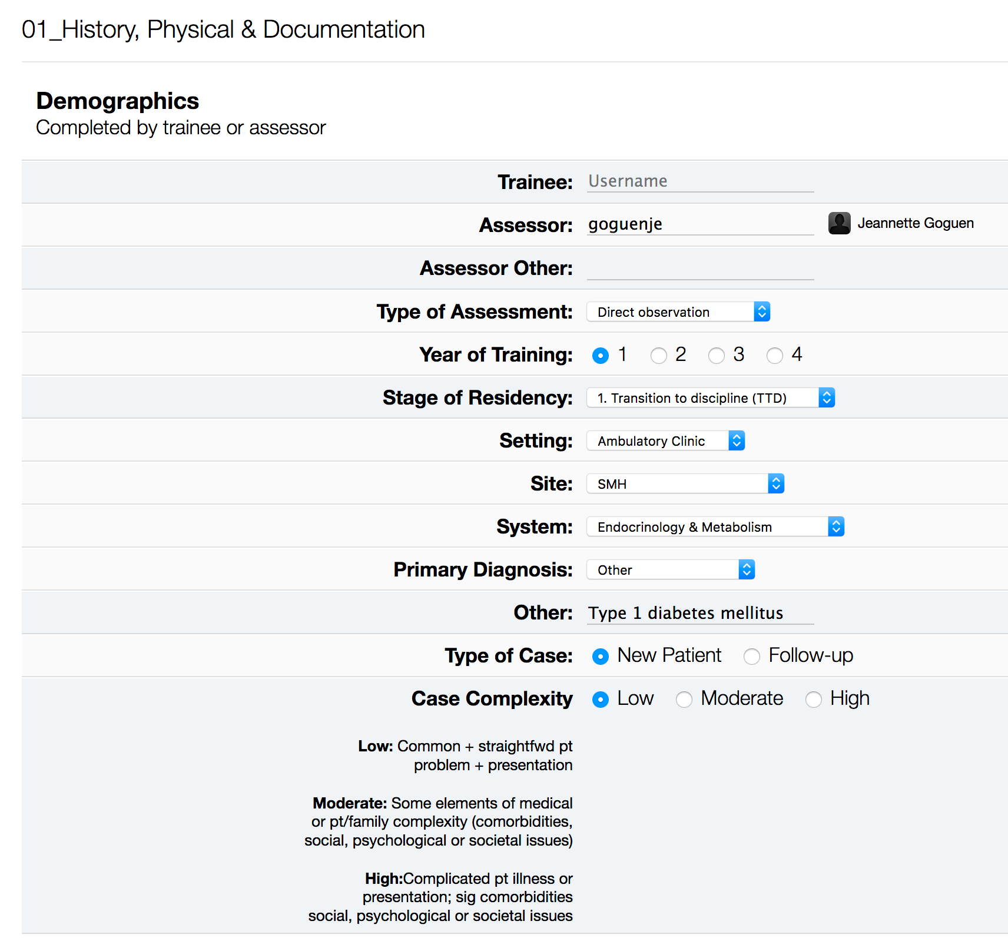

Slide 22
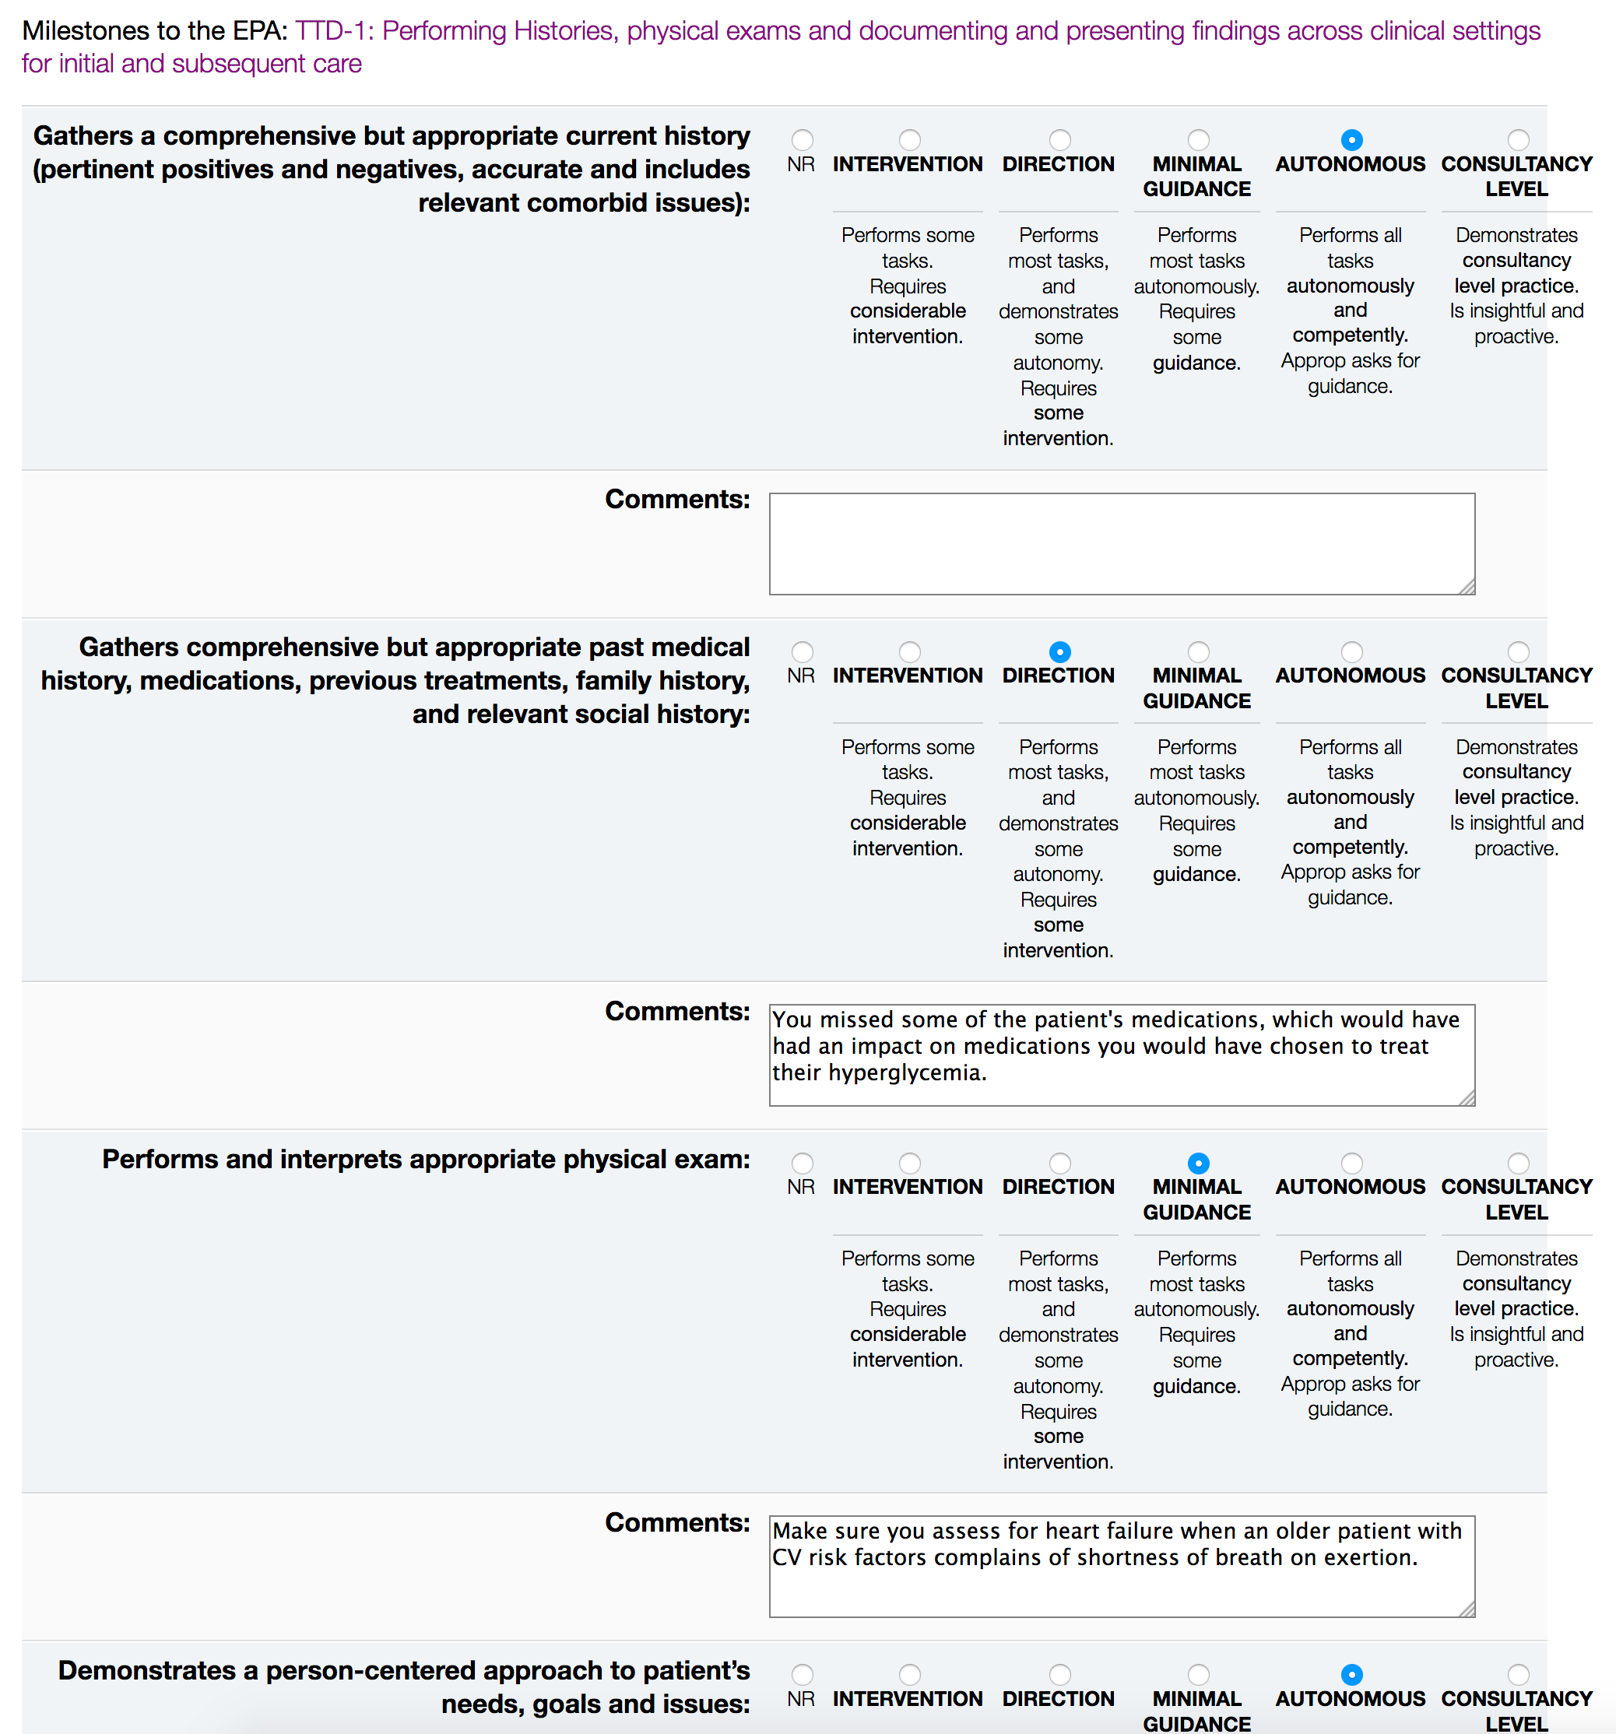

Slide 23
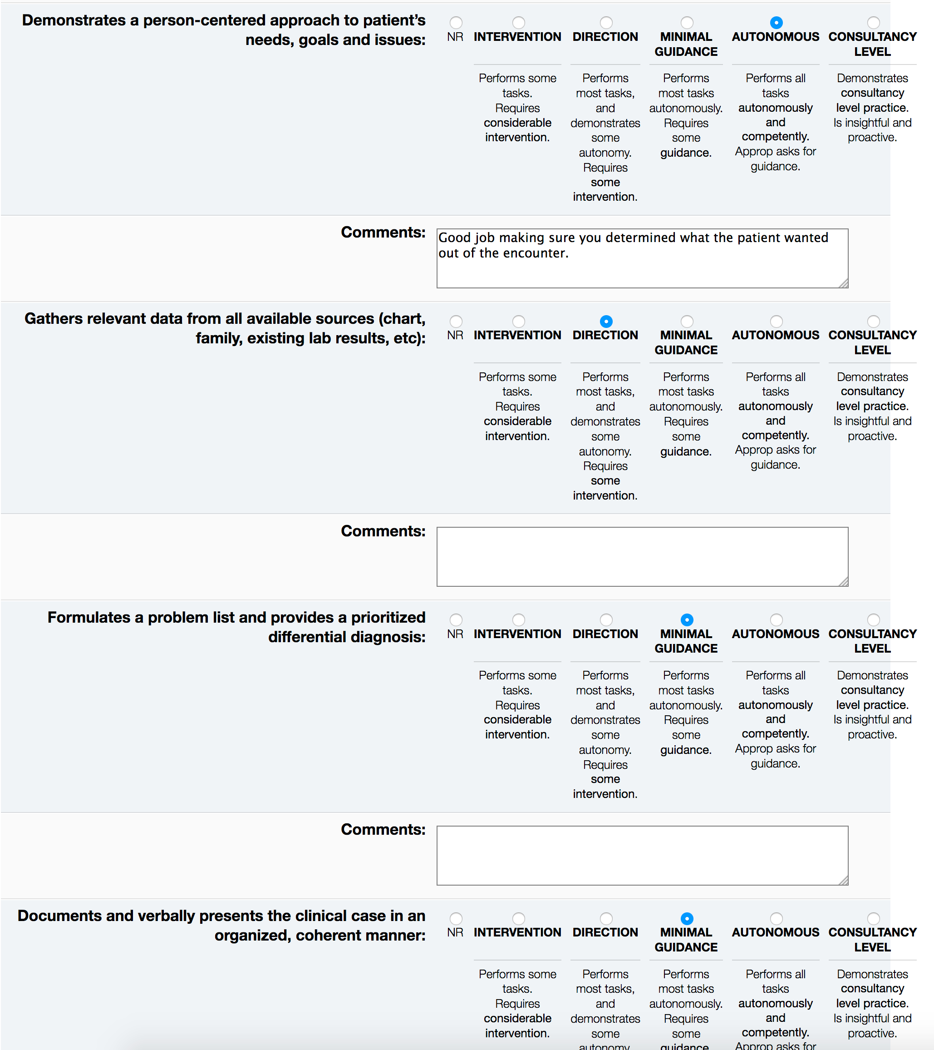

Slide 25
EPA 101 Video
Sample intro video from IM, U of T:
https://www.youtube.com/watch?v=MVmp8pYRswE

Slide 26
Failure to Fail

Slide 27
Developing a Positive Feedback Culture
Feedback is hard to give
Don’t know how recipient will react
Sometimes incorrectly viewed as “giving bad news”
Feedback is hard to take
Can trigger intense reactions if viewed as an attack or judgment on their personal worthiness, instead of convo to support their improvement

Slide 28
Steps to Giving Good Feedback
Ask if feedback is wanted
Consider performance & educational goals
Giver/receiver need a shared understanding of expectations
Allot sufficient time
Choose a private setting
Engage trainee in reflection
Use clear language
Factually describe performance
Focus your message
Coach for improvement

Slide 29
Thank you for your time
Questions about CBD?
IM-specific
Dr. Jeannette Goguen
Program Director, Internal Medicine
goguenj@smh.ca
Resources:
http://www.deptmedicine.utoronto.ca/competence-design
General
CBME PGME
University of Toronto
cbme.pgme@utoronto.ca
Dr. Susan Glover Takahashi
Director, Education Integration & Research
Lead for CBME for PGME
sglover.takahashi@utoronto.ca

